Slide 1
Progress report
10/17

Slide 2
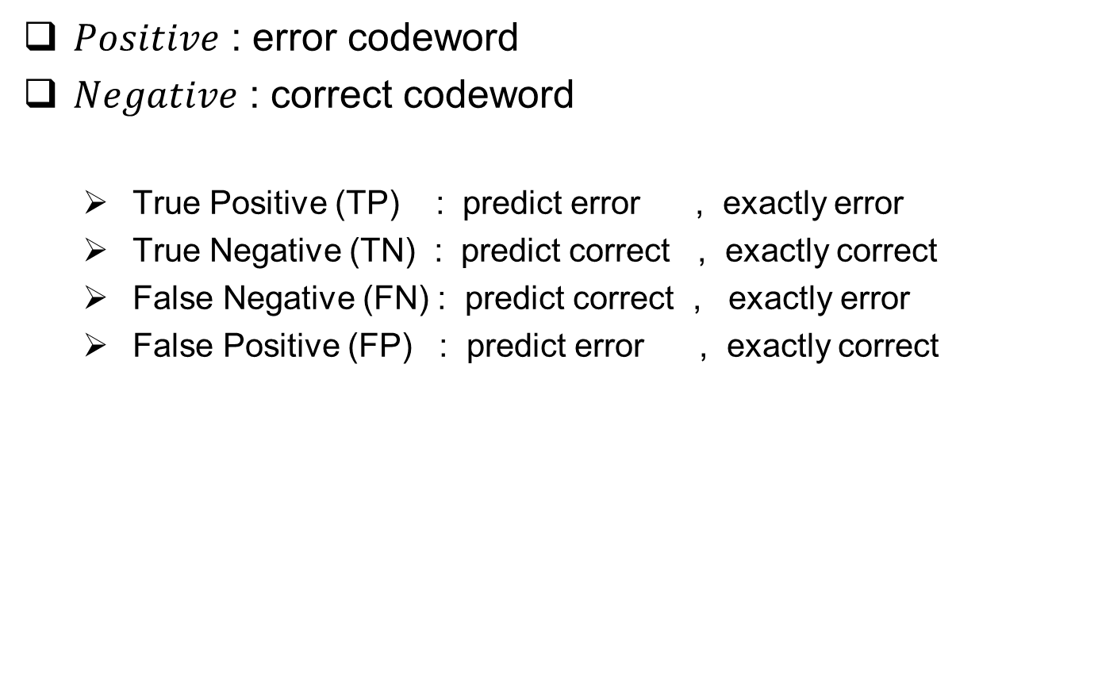
Evaluation metric
$Positive$ : error codeword
$Negative$ : correct codeword
True Positive (TP) : predict error , exactly error
True Negative (TN) : predict correct , exactly correct
False Negative (FN) : predict correct , exactly error
False Positive (FP) : predict error , exactly correct

Slide 3
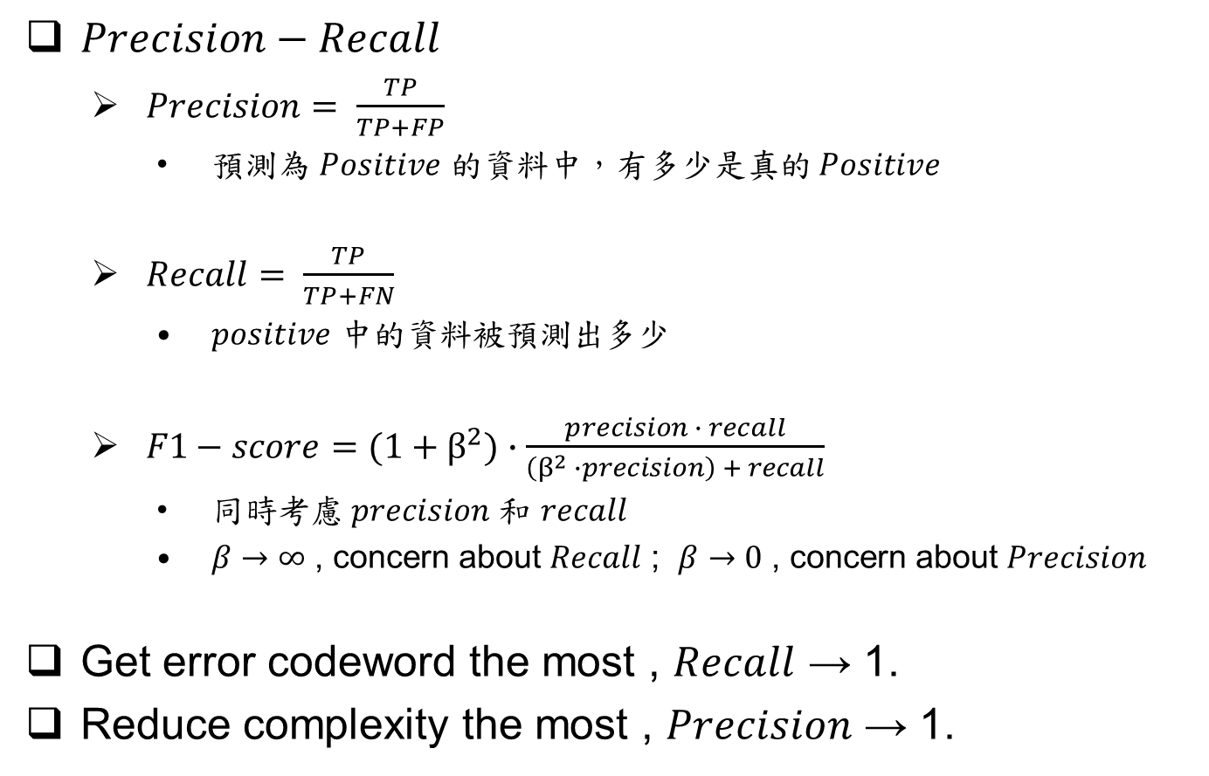
Evaluation metric
$Precision−Recall$
$Precision= \frac{TP}{TP+FP}$
預測為 $Positive$ 的資料中，有多少是真的 $Positive$
$Recall= \frac{TP}{TP+FN}$
$positive$ 中的資料被預測出多少
$F1−score=(1+β^{2})∙\frac{precision ∙ recall}{\left(β^{2} ∙precision\right) + recall}$
同時考慮 $precision$ 和 $recall$
$β→∞$ , concern about $Recall$ ; $β→0$ , concern about $Precision$
Get error codeword the most , $Recall$ → 1.
Reduce complexity the most , $Precision$ → 1.

Slide 4

Evaluation metric
$TPR−FPR$
$TPR= \frac{TP}{TP+FN}$
The same as $precision$
預測為 $Positive$ 的資料中，有多少是真的 $Positive$
$FPR= \frac{FP}{FP+TN}$
$Negative$ 被誤認成 $positive$ 的比例

Slide 5
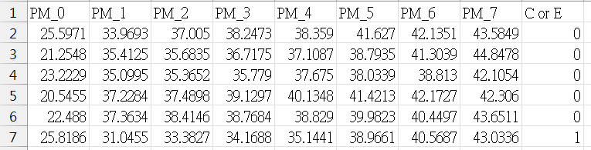
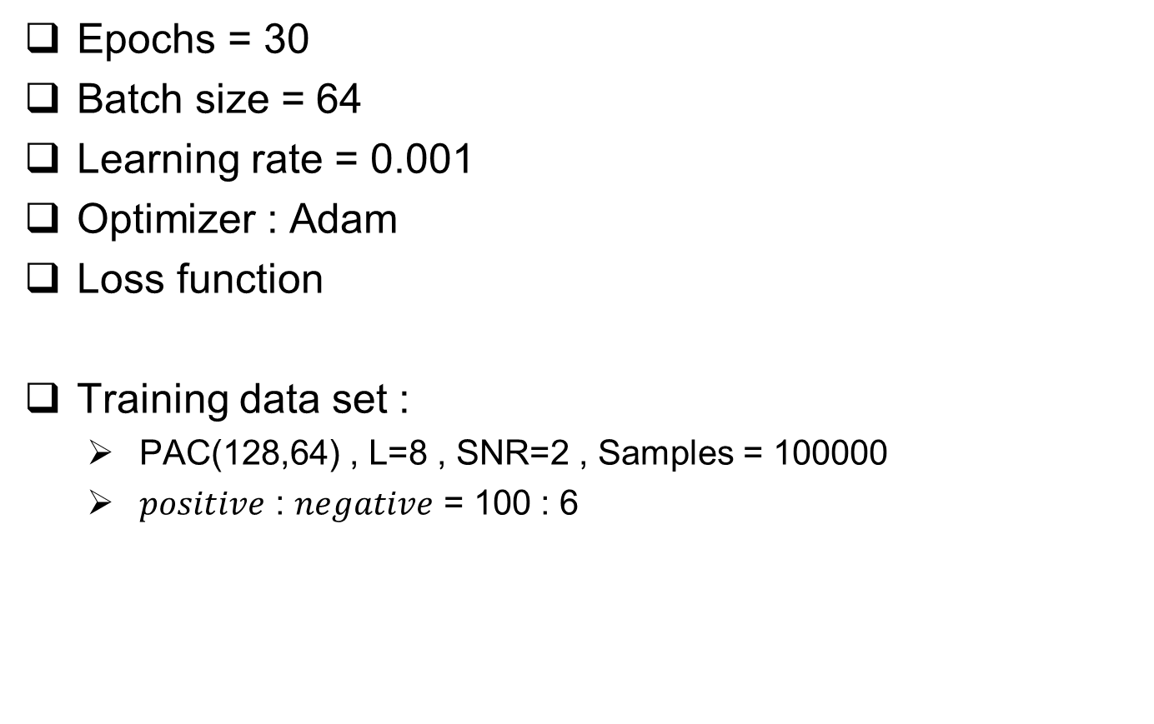
Scenario
Epochs = 30
Batch size = 64
Learning rate = 0.001
Optimizer : Adam
Loss function
Training data set :
PAC(128,64) , L=8 , SNR=2 , Samples = 100000
$positive$ : $negative$ = 100 : 6

Slide 6
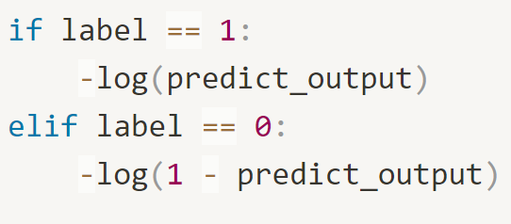
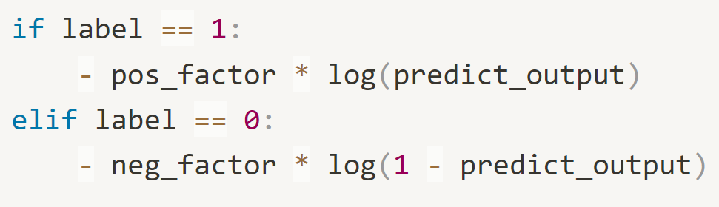
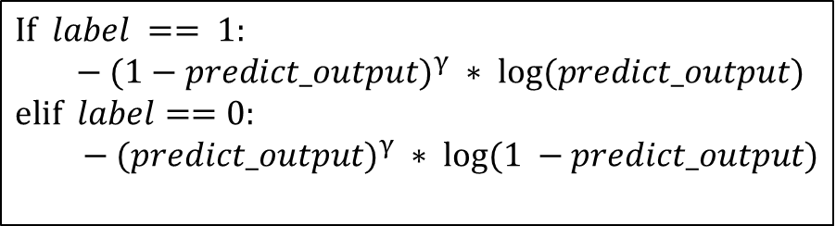
Loss function
Binary cross entropy
Weighted BCE
Focal
$$If label == 1:$$
$$− (1−predict_output)^{γ} ∗ log⁡(predict_output)$$
$$elif label==0:$$
$− (predict_output)^{γ} ∗ log⁡(1 −predict_output)$

Slide 7


model
$${PM}_{0},{PM}_{1},…,{PM}_{7}$$
$${PM}_{0},{PM}_{1},…,{PM}_{7}$$
Input layer (8)
LSTM layer (16)
Fully connected layer (16)
PReLU
Fully connected layer (4)
PReLU
Fully connected layer (4)
PReLU
Fully connected layer (1)
Sigmoid
Fully connected layer (1)
Sigmoid
output
output

Slide 8
BCE
 | Recall | Precision | accuracy
DNN | 0.942 | 0.937 | 0.992
 | Recall | Precision | accuracy
LSTM | 0.941 | 0.938 | 0.993

Slide 9
BCE
 | Recall | Precision | accuracy
DNN | 0.944 | 0.934 | 0.992
 | 0.94 | 0.945 | 0.993
 | 0.938 | 0.945 | 0.993
 | 0.949 | 0.924 | 0.992
 | 0.95 | 0.924 | 0.992
 | 0.932 | 0.953 | 0.993
 | 0.944 | 0.936 | 0.993

Slide 10
BCE
 | Recall | Precision | accuracy |  |  | Model
LSTM | 0.993 | 0.945 | 0.993 |  |  | 1
 | 0.951 | 0.924 | 0.992 |  |  | 2
 | 0.941 | 0.938 | 0.993 |  |  | 3
 | 0.874 | 0.977 | 0.991 |  |  | 4
 | 0.945 | 0.934 | 0.992 |  |  | 5
 | 0.913 | 0.956 | 0.992 |  |  | 6
 | 0.943 | 0.937 | 0.993 |  |  | 7
 | 0.903 | 0.967 | 0.992 |  |  | 8

Slide 11
Weighted BCE
DNN | Recall | Precision | accuracy
5 : 1 | 0.966 | 0.891 | 0.991
5 : 1 | 0.976 | 0.862 | 0.989
5 : 1 | 0.959 | 0.905 | 0.991
10 : 1 | 0.983 | 0.806 | 0.984
10 : 1 | 0.981 | 0.814 | 0.985
10 : 1 | 0.986 | 0.788 | 0.983
LSTM | Recall | Precision | accuracy
5 : 1 | 0.972 | 0.884 | 0.990
5 : 1 | 0.96 | 0.895 | 0.991
5 : 1 | 0.97 | 0.886 | 0.990
10 : 1 | 0.985 | 0.808 | 0.984
10 : 1 | 0.984 | 0.828 | 0.986
10 : 1 | 0.988 | 0.801 | 0.984

Slide 12

Focal $(γ=2)$
DNN | Recall | Precision | accuracy
5 : 1 | 0.951 | 0.920 | 0.992
5 : 1 | 0.959 | 0.908 | 0.991
5 : 1 | 0.956 | 0.911 | 0.992
LSTM | Recall | Precision | accuracy
5 : 1 | 0.955 | 0.918 | 0.992
5 : 1 | 0.965 | 0.893 | 0.991
5 : 1 | 0.968 | 0.888 | 0.991

Slide 13
Change model
Increase number of nodes in Model.
Input layer (8)
LSTM layer (32)
LSTM layer (32)
Fully connected layer (32)
LSTM layer (32)
PReLU
Fully connected layer (8)
PReLU
Fully connected layer (8)
Fully connected layer (8)
PReLU
Fully connected layer (1)
PReLU
Sigmoid
Fully connected layer (1)
Fully connected layer (1)
Sigmoid
output
Sigmoid
output
output

Slide 14
BCE
 | Recall | Precision | accuracy
DNN | 0.949 | 0.93 | 0.992
DNN | 0.913 | 0.959 | 0.992
DNN | 0.951 | 0.928 | 0.992
LSTM | 0.964 | 0.896 | 0.991
LSTM | 0.943 | 0.936 | 0.993
LSTM | 0.947 | 0.931 | 0.992
Stacked | 0.938 | 0.941 | 0.993
Stacked | 0.943 | 0.938 | 0.993
Stacked | 0.95 | 0.932 | 0.993

Slide 15

Change train data set
Training data set :
PAC(128,64) , L=8 , SNR=2 , Samples = 100000
$20≤PM[0]<35$
$positive$ : $negative ≈$ 10 : 1

Slide 16
Bounded test data set
Unbounded test data set
 | Recall | Precision | accuracy
DNN | 0.850 | 0.870 | 0.963
DNN | 0.897 | 0.823 | 0.961
DNN | 0.870 | 0.849 | 0.962
Recall | Precision | accuracy
0.940 | 0.940 | 0.993
0.953 | 0.920 | 0.992
0.948 | 0.929 | 0.992
Bounded test data set
Unbounded test data set
 | Recall | Precision | accuracy
LSTM | 0.875 | 0.849 | 0.963
LSTM | 0.865 | 0.859 | 0.963
LSTM | 0.837 | 0.877 | 0.963
Recall | Precision | accuracy
0.947 | 0.930 | 0.992
0.941 | 0.937 | 0.993
0.934 | 0.947 | 0.993

Slide 17

summary
Result :
Recall and Precision are traded-off.
$Recall = Precision ≈$ 0.94
Performance keep almost the same.

Slide 18
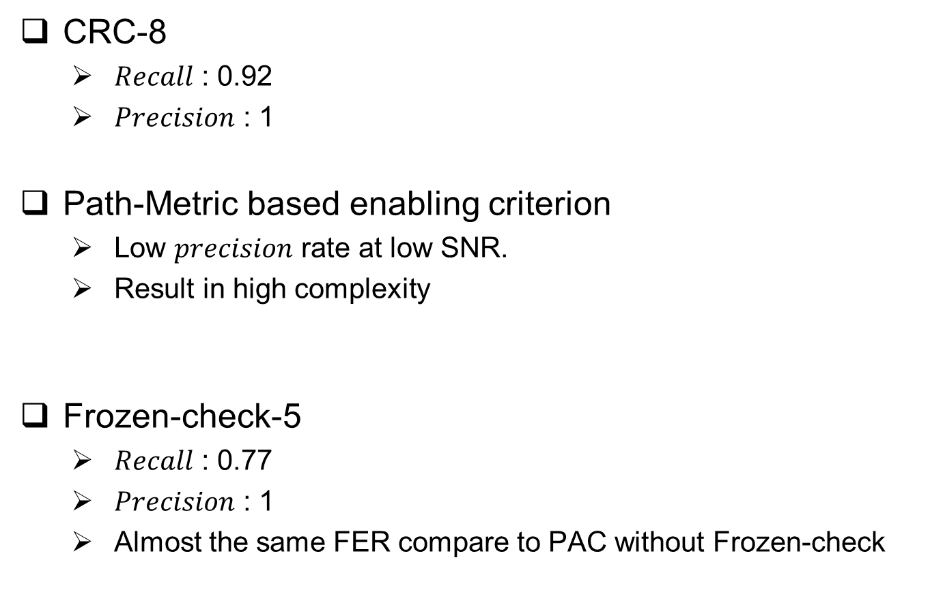
Discussion
CRC-8
$Recall$ : 0.92
$Precision$ : 1
Path-Metric based enabling criterion
Low $precision$ rate at low SNR.
Result in high complexity
Frozen-check-5
$Recall$ : 0.77
$Precision$ : 1
Almost the same FER compare to PAC without Frozen-check

Slide 19
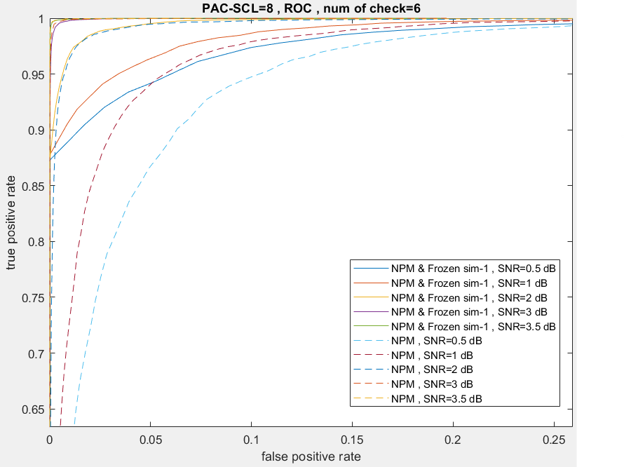

Slide 20
123
PAC-
SCLFlip
PAC-
SCL
Enabling
criterion
Enabling
criterion
Frozen
check
Frozen
check

Slide 21
做分段的 recall , precision，分段的部分用實際的 data測。
做 deep learning based flippingSet

